Slide 1
Magnetism

Slide 2
By the end of this lesson, you should be able to:
Describe magnetic forces.
Explain what a magnet is.
Predict whether magnetic poles will attract or repel each other.

Slide 3
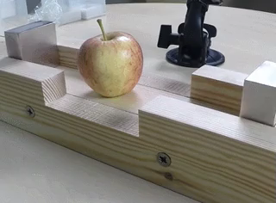
Magnetism is a type of force.
Remember that a force is a push or pull that is applied to one object by another object.
Force is measured in newtons (N). The larger a force is, the more newtons it has.

Slide 4
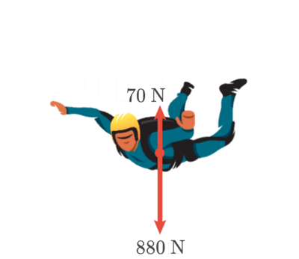
Forces have both a size (called the magnitude) and a direction.
We represent forces with arrows. The direction that the arrow points in represents the direction that the force acts in, and the length of the arrow represents the force's magnitude.

Slide 5
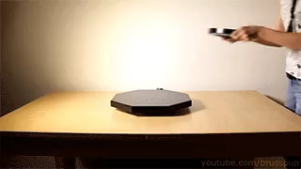
Magnetism is a special type of force, called a non-contact force.
This means that it can act between objects that are not touching.
Gravity is another example of a non-contact force. You can still feel gravity pulling you down to Earth when you jump in the air, and the same principle applies to magnetism.

Slide 6
Magnets are a special class of objects that generate magnetic forces.
This means that they can push or pull on other magnets or magnetic materials.

Slide 7
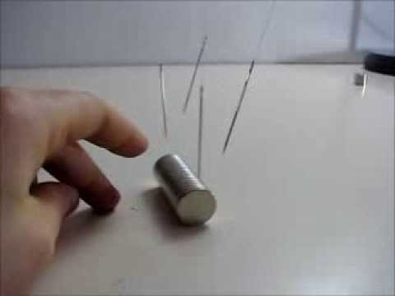

Slide 8
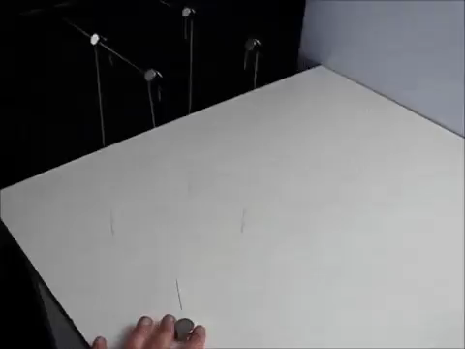
Magnetic materials are special materials that can be attracted by magnetic forces but do not generate their own magnetic forces.
In the video on the previous slide, you might have noticed that the nails were attracted to the magnet but were not attracted to each other.
This indicates that the nails were made out of a magnetic material!

Slide 9
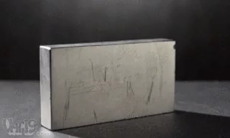
Some common magnetic materials are iron, nickel and cobalt.
If you had an iron nail for example, you could not use it to attract another iron nail, but it would be attracted to a magnet.
An alloy is a metal that is made of a combination of metals. Alloys made of iron, nickel or cobalt are also affected by magnets. Steel is an example of an alloy that is attracted to magnets.
There are special processes that turn magnetic materials into magnets. This is called magnetisation.

Slide 10
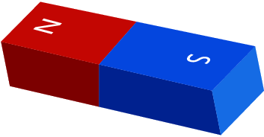
All magnets have a south pole and a north pole.
The south pole has the symbol S and the north pole has the symbol N.
One common type of magnet is the bar magnet (pictured below).

Slide 11
A bar magnet is a type of permanent magnet, which means that it always produces a magnetic force.
When two bar magnets are brought together, they will either attract or repel each other.
When two like poles are brought together, the magnets will repel each other.
When two opposite poles are brought together, the magnets will attract each other.

